Slide 1
FY22 MA Early College State Budget Needs
ECJC Recommendation to BHE
FY22 funding recommendation: in accordance with the ECJC’s charge, and respectfully acknowledging current budget uncertainties, the ECJC recommends the following allocation for the FY22 state budget:
Concurrent and Dual Enrollment Programs line item (7066-0019): increase funding for Early College uses from $2M (FY21) to $6.4M.
Student impact: This recommendation represents funding growth needed to allow an estimated 5,951 high school students at 28 early college high school programs across the state take 15,828 courses, which is about 1,500 full-time college-years of credit. This would sustain current Early College students and programs as well as approve five new, select, high quality programs for designation.
Other uses for line item: The above recommendation does not include other potential needs and uses of this line item, particularly for dual enrollment.

Slide 2
Massachusetts Early College Preliminary Outcomes
Pierre Lucien
Policy Analyst, Department of Elementary and Secondary Education
Strategic Data Project (SDP) Fellow, Harvard University
Board of Higher Education
October 2020

Slide 3
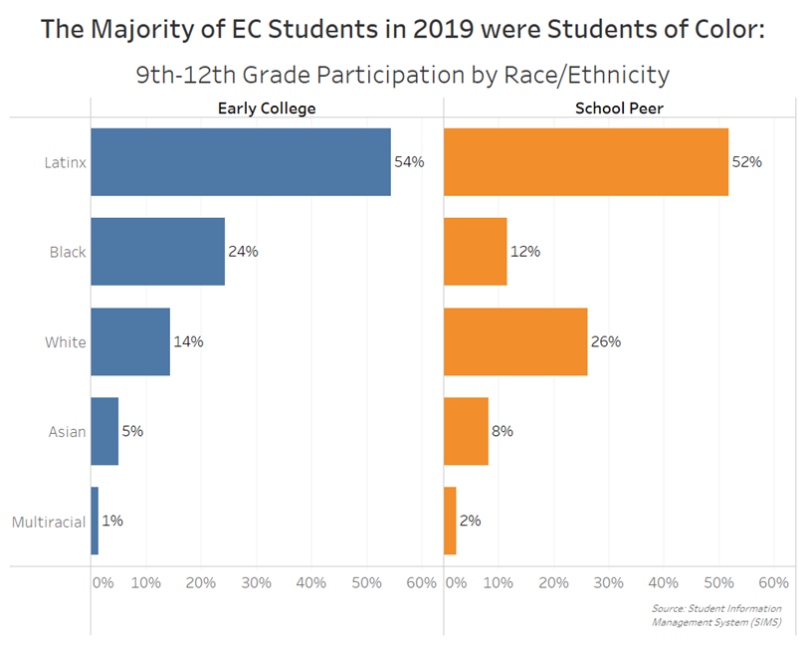
*

Slide 4
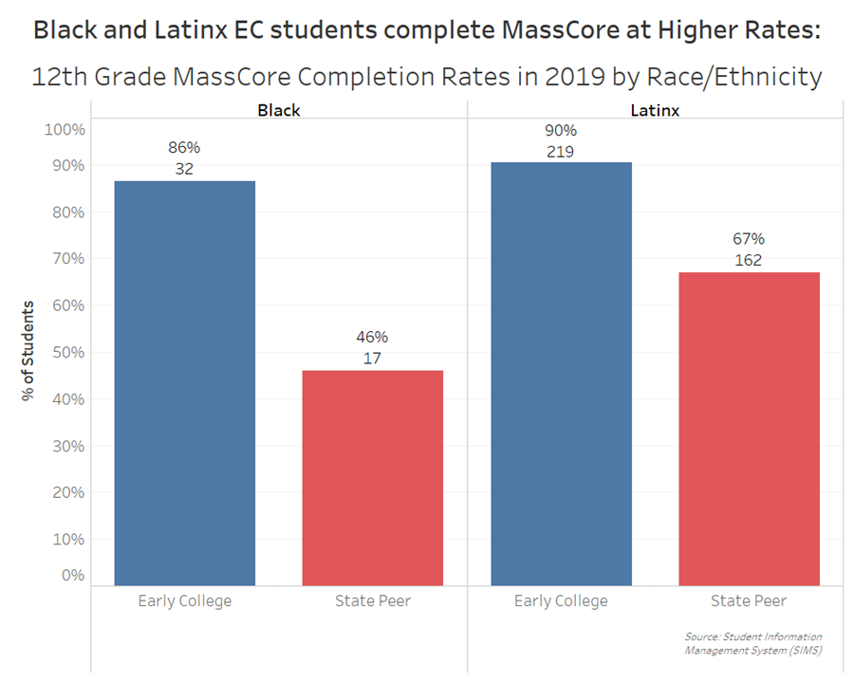

Slide 5
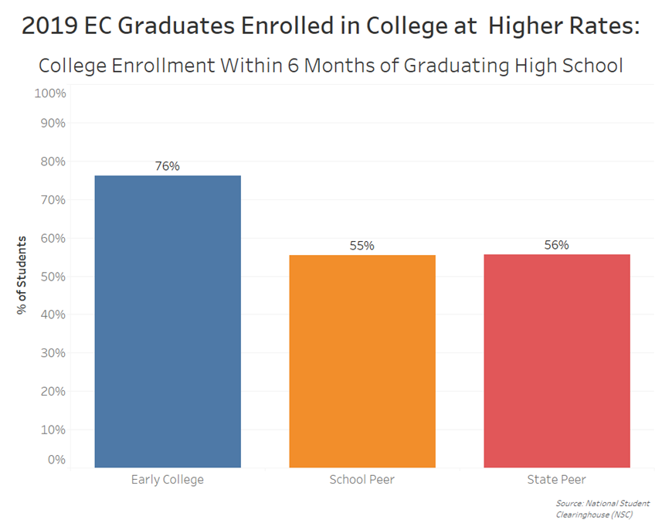
Note: 93% of these 12th graders enrolled in MA institutions (77% enrolled in public higher education institutions)

Slide 6
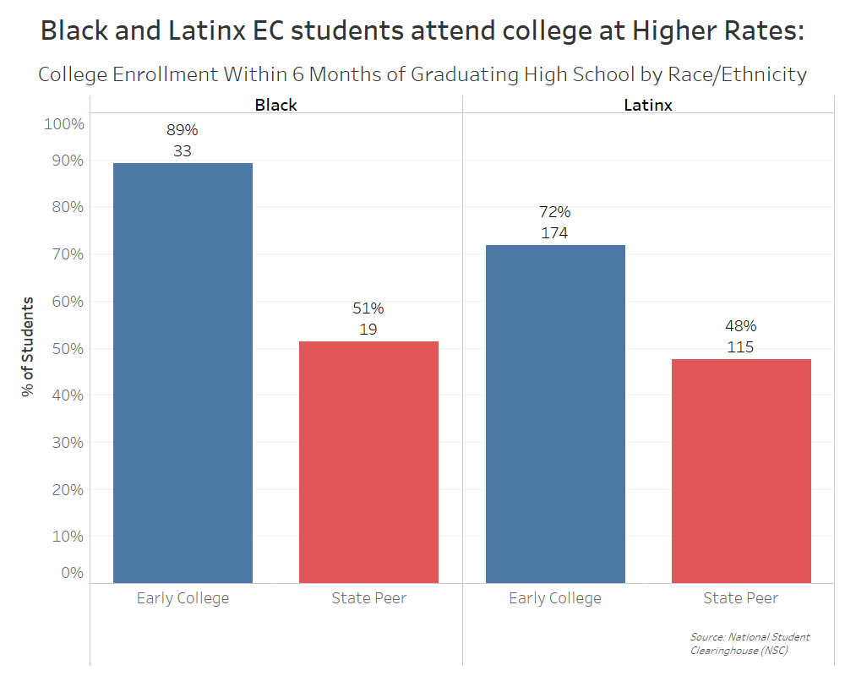

Slide 7
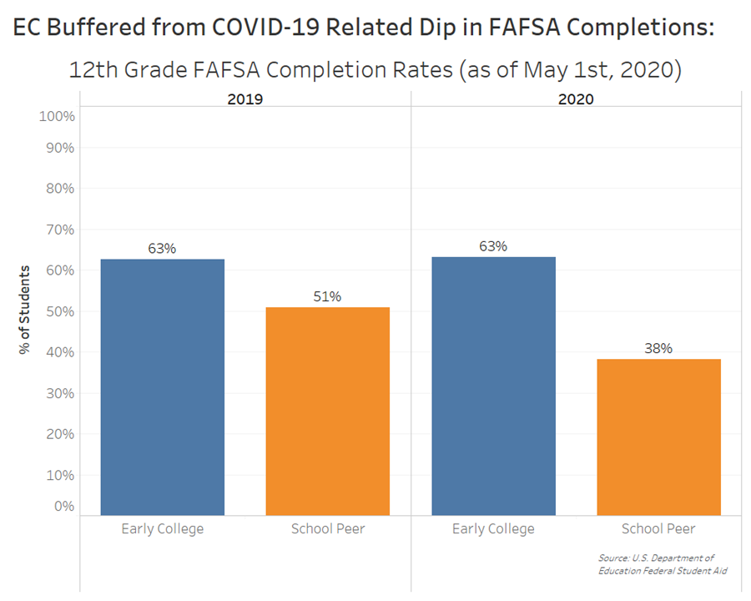

Slide 8
Massachusetts Early College Growth and Projected Budget Needs
Kristin Hunt
Director, Early College Programs
Department of Elementary and Secondary Education
Board of Higher Education
October 2020

Slide 9
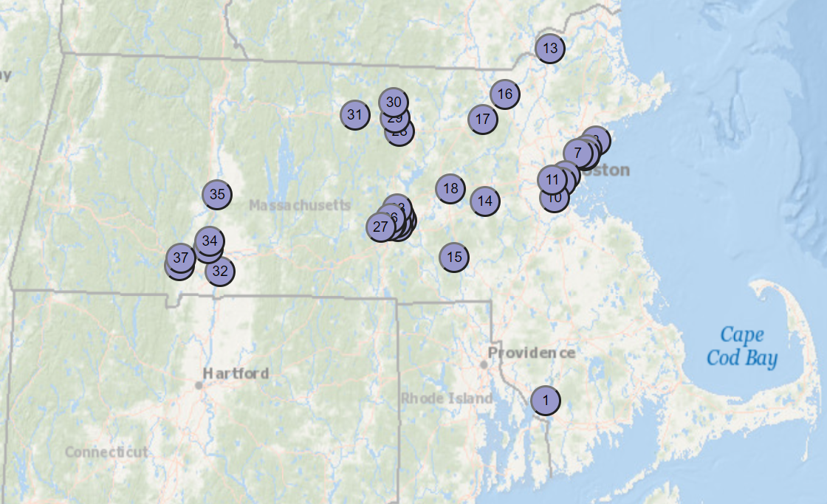
Growth in Early College Participation
37 high schools and 19 higher education institutions house Early College programs, including 11 of 15 community colleges, 6 of 9 state universities, and 2 private colleges.
Participating Institutions of Higher Ed
(Bold = new designations in 2020)
Bridgewater State University
Bristol State Community College
Bunker Hill Community College
Cambridge College
Fitchburg State University
Framingham State University
Greenfield Community College
Holyoke Community College
Massachusetts Bay Community College
Mount Wachusett Community College
Massasoit Community College
Merrimack College
Middlesex Community College
North Shore Community College
Northern Essex Community College
Quinsigamond Community College
Salem State University
Westfield State University
Worcester State University

Slide 10
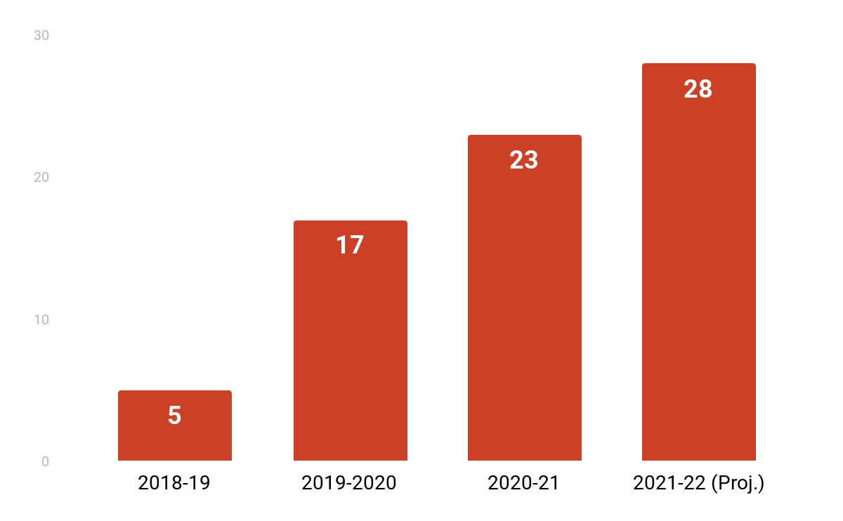
Growth in Designated Early College Programs
Interest and enthusiasm for this approach has grown and continues to expand across the state
Number of Designated Early College Programs

Slide 11
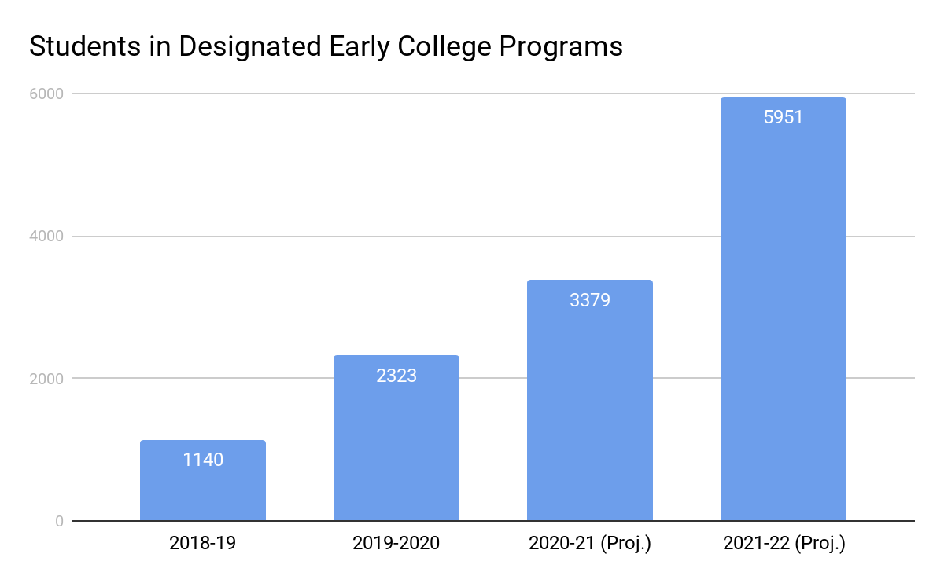
Growth in Student Enrollment in Early College Programs
Interest and enthusiasm for this approach has grown and continues to expand across the state

Slide 12
Growth Projections and Associated Budget Needs
Projections are informed by cross-departmental collaboration and represent meaningful and realistic growth
Growth projections for Early College in the 2021-22 school year are informed by collaboration with colleagues at DHE, DESE, and EOE:
~6K high school students
28 early college programs (assumes approving five new, high quality programs for designation)
~16K courses (the equivalent of ~1,500 full-time college-years of credit)
The $6.4M CDEP line item recommendation is consistent with this level of funding growth and assumes a reduced per-credit rate of $135/credit

Slide 13
Resolution on Early College Funding
“In recognition of the progress and initial success of the Early College Initiative, and consistent with discussions which took place during the September 30, 2020 meeting of the Early College Joint Committee, the Board of Higher Education (BHE) intends to recommend for Fiscal Year 2022 that the Department of Higher Education’s Commonwealth Dual Enrollment Program (CDEP) line item (7066-0019) include $6.4 million for use by institutions of higher education participating in the Early College Initiative to meet the costs of college courses offered to students in designated Early College programs across the Commonwealth. Provided further that the BHE recognizes that the final CDEP line item may also include expanded funding for other uses such as Dual Enrollment, above and beyond the $6.4 million allocation for use to support the Early College Initiative.”
No.: BHE 21-33
Board date: October 20, 2020

